Slide 1
A Picture of Health?
A review of the quality of physical healthcare provided to adult patients admitted to a mental health inpatient setting
Key messages and recommendations
Notes:
Presenter’s notes:
This presentation can be used to present the principal recommendations from the report ‘A Picture of Health?’. This looked at the quality of physical healthcare provided to adult patients aged over 18 years who were admitted to a mental health inpatient setting. The study covered the all NHS, independent or not-for profit inpatient mental health hospitals in the UK.
More information can be found at https://ncepod.org.uk/2022phmh.html

Slide 2
The study
A review of the quality of physical healthcare provided to adult patients admitted to a mental health inpatient setting
Trust level Organisational questionnaire
Hospital level Organisational questionnaire
Clinician questionnaire
Case note review
Notes:
Presenter’s notes:
The study described in this report aimed to identify and explore remediable factors in the clinical and organisation of the physical healthcare provided to adult patients admitted to a mental health inpatient setting.
The consultant psychiatrist caring for the patient at admission completed a questionnaire and returned this alongside copied extracts of the case notes. These data were peer reviewed by a multidisciplinary group of clinicians to assess the quality of physical healthcare patients had received.
An organisational questionnaire was disseminated to each mental health trust/local health board, and independent mental healthcare provider identified as meeting the criteria to participate. An additional organisational questionnaire was disseminated to each inpatient unit with patients in the study to focus questions on aspects of service provision that may have varied within the organisation.

Slide 3
The study
Anonymous open access online surveys for
Healthcare professionals working in mental health inpatient settings
Patients
Carers
Notes:
Presenter’s notes:
The views of both service users and their carers and mental healthcare professionals were collected.
The anonymous surveys were circulated online to allow patients (and their carers) with physical health conditions who were admitted to a mental health inpatient setting to provide their views on the care they received as an inpatient.
An anonymous open access survey was also circulated to healthcare professionals working in mental health inpatient settings regarding their own confidence and competencies in delivering physical healthcare.

Slide 4
Study population
Adults aged 18 years and older who were admitted to a mental health inpatient setting for a period of more than one week during the study period of 1st November 2018 to 31st October 2019, and who had one or more of the following concomitant physical health conditions* recorded on discharge from the mental health facility:
Chronic obstructive pulmonary disease/asthma
Cardiovascular disease
Diabetes
OR: The physical health condition of the patient necessitated an acute transfer to a physical health hospital for assessment/ treatment/ stabilization
OR: The patient died in the mental health inpatient setting or within 30 days of discharge from the mental health inpatient setting
Notes:
Presenter’s notes:
*Physical health condition refers to pre-existing or newly identified health conditions requiring ongoing assessment/treatment.

Slide 5
Study population
Exclusions
Suicides, homicides and self-harm related deaths as this group of patients is covered by the National Confidential Inquiry into Suicide and Safety in Mental Health (NCISH)
Patients in hospitals who were part of tertiary commissioned services – these encompassed patients with dementia, other organic brain injury or learning disability not in conjunction with any other mental health condition
Notes:
Presenter’s notes:

Slide 6
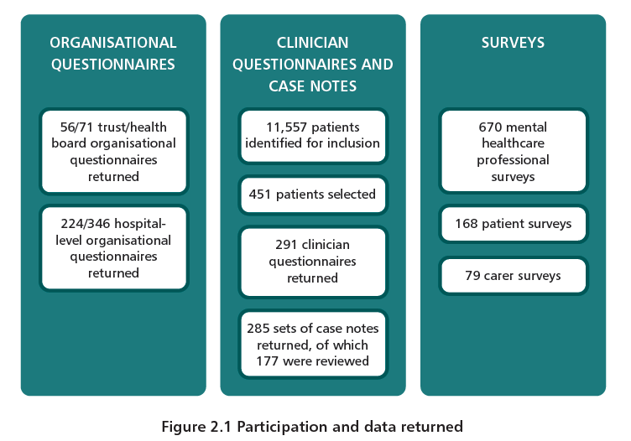
Study sample
Notes:
Presenter’s notes:
The impact of the COVID-19 pandemic on the data collection must be acknowledged. However, while the pandemic impacted on the process of returning data to NCEPOD (data collection was delayed by approximately eight months) it did not impact on the quality of data received. While the sample included was slightly smaller than originally planned, it was large enough to make this a viable report.
The total study population of 11,557 patients had a mean age of 57.4 years and mode of 72 years. The older age group reflected in this population and the sample selected for review highlights the importance of providing a collaborative approach to physical healthcare for those likely to have the most comorbidities.

Slide 7
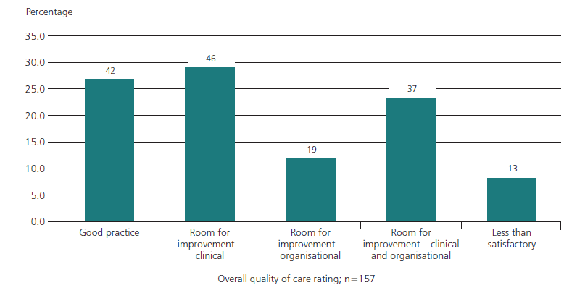
Overall assessment of care
Figure 12.2 Overall quality of care
Case reviewer data
Notes:
Presenter’s notes:
Case note reviewers assessed the overall quality of care for each case. 47.3% were felt to demonstrate good practice, whilst another ~ 45% showed room for improvement in clinical care.
The care of 9 patients was considered to be less than satisfactory.

Slide 8
Key messages (1)
Assess patients for acute physical health conditions on arrival at a mental health inpatient setting and then undertake a detailed physical health assessment once the patient is admitted
Patients admitted for mental healthcare but who are also physically unwell need complex care. Patients may need a transfer to a physical health hospital for an acute condition, and/or they may have at least one long-term physical health condition that needs monitoring. Physical health conditions were not included in the initial clerking for 29/150 (19.3%) patients and a detailed physical health assessment was not undertaken appropriately for 28/126 (22.2%) patients.
Notes:
Five key messages have been agreed as the primary focus for action, based on the report findings and recommendations
Several areas of concern were highlighted in line with expectations for this group of patients, broadly relating to issues with the documentation of

Slide 9
Key messages (2)
Develop a physical healthcare plan for patients
admitted to a mental health inpatient setting
The ongoing physical healthcare of patients should be monitored to prevent deterioration. A plan for physical health observations was not documented for 48/217 (22.1%) patients and no advice was given about who should be notified in the event of physical health concerns for 47/169 (27.8%) patients. Physical healthcare plans were formulated for only 155/291 (53.3%) patients.

Slide 10
Key messages (3)
Formalise clinical networks/pathways between
mental healthcare and physical healthcare
Mental healthcare staff need support in providing physical healthcare. There were 127/268 (47.4%) mental healthcare professionals surveyed who reported feeling ‘fairly’/‘less than fairly’ confident or competent in caring for patients with long-term conditions and 216/317 (68.1%) thought there was scope for improvements in the hospital’s networks with local physical healthcare providers. Local care pathways or pre-existing arrangements with physical healthcare providers were used as part of the care plan for 71/291 (24.4%) patients in this study.

Slide 11
Key messages (4)
Involve patients and their carers/friends/family in their physical healthcare and use the admission as an opportunity to assess, and involve patients in their general health
Hospital admissions are an excellent opportunity to assess and help improve a patient’s general physical health and including family/carers can be a great form of support. There were 15/29 organisations with a physical health strategy that had a specific commitment to improve communication about physical health with patients and carers. However, there was no record that the findings of the physical health review had been discussed with the patient’s family/carers in 100/188 (53.2%) sets of notes reviewed.

Slide 12
Key messages (5)
Include mental health and physical health
conditions on electronic patient records and allow
sharing across healthcare providers
Effective electronic patient records (EPR) for physical as well as mental health, should be shared across providers, to improve patient safety and make communication easier. While all organisations apart from one had some form of EPR system, only 20/56 reported that all elements of the clinical record were available on it and only 244/405 (60.2%) clinicians using the systems thought the EPR allowed easy viewing/input of the patient’s physical health needs.

Slide 13
Recommendation 1
On arrival at a mental health inpatient setting, check if the patient faces any acute risks to their physical health, including physical health risks associated with rapid tranquilisation and take appropriate action.
Target audience: Mental healthcare professionals and receiving mental health ward medical and nursing staff
Notes:
Presenter’s notes:
The report, which makes 12 recommendations for clinicians and management to implement in practice, highlights there is room for improvement in the quality of physical health care provided to adult patients admitted to an inpatient mental health setting
Rec 1 . Physical health conditions were not included in the initial medical clerking for 29/150 (19.3%) patients
110/177 (62.1%) patients had a condition that could have impacted the safety of rapid tranquilisation and found that this information was not properly documented nor communicated to the relevant staff in 61/110 (55.5%) cases reviewed

Slide 14
Recommendation 2
On admission to a mental health inpatient setting, carry out and record an initial physical health assessment on all patients. If the patient has the mental capacity to consent to undergo a physical health assessment but refuses, document this then and try again as soon as practicable.
This should start within 4 hours* and include:
Baseline observations including blood pressure, heart rate and respiratory rate and temperature and oxygen saturation
Details of existing physical health conditions and any acute changes since the last clinical review
Current medication (physical and mental health) including side effects and adherence
Whether the patient is at risk of withdrawal from drugs/alcohol
Height, weight, relevant blood tests (use recent blood tests if appropriate) and an ECG
Notes:
Presenter’s notes:
*The 4 hour timeframe is line with the Royal College of Psychiatrists Standards for Inpatient Mental Health Services (2022)
33/291 (11.3%) patients did not have an initial physical health assessment at the time of admission to hospital

Slide 15
Recommendation 2 continued
Hydration status and a fluid balance plan
Dietary status, with input from the nutrition team as necessary
Review of physical health risks associated with rapid tranquilisation
The frequency of repeat physical health observations, relevant to the patient’s condition, using the National Early Warning Score (NEWS2) where appropriate
Target audience: Mental healthcare professionals with support from allied health professionals
Notes:
Presenter’s notes:
*The 4 hour timeframe is line with the Royal College of Psychiatrists Standards for Inpatient Mental Health Services (2022)

Slide 16
Recommendation 3
Within 24 hours of admission to a mental health inpatient setting, collaboratively develop and document a physical healthcare plan with every patient, based on their initial physical health assessment. Where applicable include:
The most appropriate healthcare location to treat the patient’s physical healthcare needs (e.g. mental health or physical health hospital)
Monitoring and treatment plans, including:
- how frequently to review the physical health risk assessment, recognising acute or chronic health conditions
- how often to repeat physical health observations and whether to use early warning tools (National Early Warning Score (NEWS2))
- a nutrition plan
The physical health support needed
Notes:
Presenter’s notes: A plan for physical health observations was not recorded for 48/217 (22.1%) patients (assess in 217/252)
#16. No advice was given to staff about who should be notified in the event of physical health concerns for 47/169 (27.8%) patients
#19. 68/252 (27.0%) patients did not have a physical health risk assessment. Where it could be determined (in 156/177; 88.1%) the case reviewers found that it was documented in the case notes of 81/156 (51.9%) patients and adequately communicated to the nursing staff on 71/81 occasions

Slide 17
Recommendation 3 continued
Escalation plans in the event of deterioration (linked to the NEWS2 score) or patient not consenting to be assessed, that include who contact and when
Identify gaps in clinical history and a plan to address them
Target audience: Mental healthcare professionals supported by physical healthcare professionals
Notes:
Presenter’s notes:

Slide 18
Recommendation 4
Within 24 hours of admission to a mental health inpatient setting, pharmacy staff (in the mental health inpatient setting, and where involved, in the physical health hospital) should undertake a full medicines reconciliation, including all medications for physical as well as mental health.
Target Audience: Pharmacy staff in mental health inpatient settings and physical health hospitals
Notes:
Presenter’s notes: This is in line with NICE Quality Standard 120 (Medicines optimisation 2016) https://www.nice.org.uk/guidance/qs120
31/237 (13.1%) patients had delays in prescription and administration of physical health medications and the case reviewers recorded delays in 26/148 (17.6%) patients who were prescribed physical health medications during their hospital stay
213/291 (73.2%) patients had a full medicines reconciliation (including receiving indicated current prescription of medication) within 24 hours of admission
36/66 patients did not have all contraindications or interactions with psychotropic medication documented that should have been

Slide 19
Recommendation 5
Develop and implement an organisational policy and protocol to ensure that patients in a mental health inpatient setting are properly assessed, and treated, for physical health conditions in a considerate and collaborative manner. This could be done by:
a. Formalising existing clinical networks or pathways for diagnosing or treating common acute conditions for example, infection or existing long-term conditions
b. Training registered mental health nurses, healthcare assistants, or any other staff as appropriate to monitor and support the management of common long-term physical conditions, while ensuring their competencies are well defined and are kept up to date
c. Collaborating with local physical health hospitals to develop a physical health liaison service
Target audience: Mental health executive boards and physical health executive boards supported by commissioners
Notes:
Presenter’s notes:
. 317/412 (76.9%) mental healthcare professionals reported that their workplace had networks, relationships or links with the nearest physical health hospital. However, 216/317 (68.1%) thought there was scope for improvements in these networks
Advice was sought from the physical health team for acute deterioration in 116/147 (78.9%) patients
20/107 (18.7%) patients had delays in identifying their acute physical deterioration by the mental health team
18/56 organisations reported a specific pathway or protocol for inpatients with specific physical health conditions

Slide 20
Recommendation 6
Develop and implement an organisational policy and protocol for the transfer to, and readmission from, a physical health hospital to a mental health inpatient setting. This should include:
a. A comprehensive clinical summary which includes, but is not limited to:
- Physical and mental health condition(s)
- Current physical and mental health care plans
- Physical and mental health medications
- Monitoring and escalation plans
- A mental health capacity assessment and the status of mental health legislation (if applicable)
Notes:
Presenter’s notes: . 317/412 (76.9%) mental healthcare professionals reported that their workplace had networks, relationships or links with the nearest physical health hospital. However, 216/317 (68.1%) thought there was scope for improvements in these networks

Slide 21
Recommendation 6 continued
b. Prompt treatment in the physical health hospital
c. A plan for readmission to the mental health inpatient setting developed by the physical and mental healthcare teams working together. Include:
- The estimated date of discharge and return to the original mental health ward
- The planning for physical healthcare provision that goes beyond what is available in the mental health inpatient setting
d. A record of transfers to a physical health hospital due to a deterioration in the physical health of a patient – this should be regularly audited for unexpected transfers
Target audience: Mental health executive boards and physical health executive boards supported by commissioners and all healthcare professionals
Notes:
Presenter’s notes:

Slide 22
Recommendation 7
Develop and implement an organisational policy and protocol to involve patients, carers/friends/family in the patient’s physical healthcare. This could include:
Enabling carers/family/friends to provide staff on the ward with information about the patient’s physical health
b. Access to clear information on what general physical health assessments are carried out when a patient is admitted to the ward
c. Access to:
- Healthy lifestyle advice
- How family/friends/carers can support good physical health
Notes:
Presenter’s notes:
127/205 (62.0%) patients had documentation as to whether the outcomes of the physical health review had been discussed with them
100/188 (53.2%) patients had documentation as to whether the outcomes of the physical health review had been discussed with their family/carers
26/60 patients stated that the clinical team fully involved them in their physical healthcare assessment and explained clearly what assessments and tests were being done,
why they were being done, and the results of any tests. However, 28/60 disagreed that this was the case and 20/35 carers reported that they had not felt involved or been communicated with about assessments and tests carried out
25/60 patients agreed that information given to them regarding their physical health was clear, understandable and encouraging and 26/60 who disagreed. Carers were also asked the same question and 15/35 did not feel this was the case
15/29 organisations reported a physical health strategy that had a specific commitment and plan to improve communication about physical health with patients and carers
164/291 (56.4%) clinician questionnaires provided detail of efforts and strategies to engage the patient in the physical health assessment process

Slide 23
Recommendation 7
d. Ensuring that with patient consent, patients and their carers/family/friends can:
- Receive updates on the patient’s physical health including transfers to physical healthcare settings
- Ask questions about the patient’s physical health needs
- Contribute to the development of and/or receive a copy of the patient’s physical healthcare plan
Receive clear information about any post-discharge follow-up physical health plans
Target audience: Mental health executive boards and mental healthcare professionals, associated patient involvement groups
Notes:
Presenter’s notes:

Slide 24
Recommendation 8
Use admissions to a mental health inpatient setting as an opportunity to assess and involve patients in their general health. A hospital policy, supporting training in a range of health improvement topics for staff who work directly with patients, could include:
a. Exercise
b. Diet
c. Smoking cessation
d. Alcohol use
e. Substance use
f. Sexual and reproductive health
g. Immunisation
h. Routine NHS screening programmes
Target audience: Mental health executive boards and physical health executive boards supported by commissioners
Notes:
Presenter’s notes:
NHSE CQUIN guidance 2016/2017
Cardio metabolic assessment
and treatment for patients with
psychoses/ Serious Mental illness (PSMI)
https://www.england.nhs.uk/wp-content/uploads/2016/03/cquin-guidance-16-17-v3.pdf

Slide 25
Recommendation 9
Offer support to patients admitted to a mental health inpatient setting who smoke tobacco, drink alcohol at harmful or dependent levels, or use other drugs. Use defined substance misuse pathways and where needed, include:
a. Assessment and screening tools
b. Specialist advice
c. Interventions and prescribed treatment (especially for dependence)
d. Follow-up after discharge, supported by the local alcohol or drugs recovery services (local health authority commissioned services)
Target audience: Mental healthcare professionals, local authorities and commissioners
Notes:
Presenter’s notes:
This is in line with Making Every Contact Count: https://www.makingeverycontactcount.co.uk/

Slide 26
Recommendation 10
Record the correct physical health diagnosis, ICD 10/ SNOMED CT codes (or equivalent) in mental health clinical records and discharge summaries.
Target audience: Mental healthcare professionals, hospital coders
Notes:
Presenter’s notes:
. 31/56 organisations reported that mental health conditions were recorded as ICD-10 codes across the organisation. There was even greater variation around ICD-10 coding for physical health conditions with only 10/56 organisations reporting that this was conducted as standard practice
Information on newly diagnosed physical health conditions was included in 70/228 (30.7%) discharge summaries and on previously known conditions in 151/228 (66.2%)

Slide 27
Recommendation 11
Ensure that electronic patient records in mental health inpatient settings:
- Have the functionality to record physical health conditions
- Have the facility for tasks to be set to aid disease and treatment monitoring
Are accessible, to allow handover between clinical teams and across healthcare providers
Target audience: Mental health executive boards, IT departments and providers of electronic patient record systems supported by NHS Digital, NHS Wales Informatics Service, Northern Ireland Statistics and Research Agency
Notes:
Presenter’s notes: . 244/405 (60.2%) mental healthcare professionals working in mental health inpatient settings, thought the electronic patient record allowed easy viewing/input of the patient's physical health needs, and 142/143 (99.3%) thought that it could be improved
55/56 organisations had some form of established electronic patient record system. However, there was variation in the comprehensiveness of the electronic system with only 20/55 reporting that all elements of the clinical record were on the electronic system
Despite the need for rapid access to a patient’s physical health records, 14/56 responding organisations had immediate electronic access to the patient’s primary care medical record with most relying on requests for this information to be sent

Slide 28
Recommendation 12
Provide a discharge summary to the patient, their carer/s, GP and community mental health team within 24 hours of discharge. This should include:
- Mental and physical health diagnoses
- All medications for mental and physical health, including who will provide them and the reason for any prescription changes
- Follow-up arrangements with the community mental health team/GP
- Mental health and physical health care plans
Any support needed to carry out the care plans
Target audience: Mental healthcare professionals
Notes:
Presenter’s notes: . 20/70 discharge summaries did not contain all the appropriate physical health information in the case reviewers’ opinion
51/70 discharge summaries available for review contained details of physical health, medications in 60/70 and mental health risk in 45/70, while exercise and hydration needs were documented in just one
8/70 discharge summaries contained information on the assessed mental capacity to care for physical health needs

Slide 29
Discussion
Are patients being checked on arrival to an inpatient mental health ward for any acute risks to their physical health?
Is a initial physical health assessment carried out for patients on admission to an inpatient mental health ward?
Has a collaborative physical health care plan been created for each patient with physical health needs
Has a full medicines reconciliation been carried out within 24 hours?
Is each admission used as an opportunity to improve physical health
Does the organisation have policies / protocols covering the assessment / treatment of the physical health of patients; transfer (if necessary to a physical health care setting; involvement of patients and carers in the patient’s physical health care
Does the organisation have an electronic patient record that allows audit/ coding of physical health conditions?
Notes:
Final slide for the presenter to begin a discussion

Slide 30
A Picture of Health?
Full report, summary and implementation tools are be found at
https://ncepod.org.uk/2022phmh.html
Notes:
https://ncepod.org.uk/2022phmh.html

